Slide 1
SNOWFLAKE TECHNICAL OVERVIEW
Jonathan Tao - Partner SE
Notes:
Hello world!

Slide 2
SNOWFLAKE: A FULL DATA WAREHOUSE, BUILT FOR THE CLOUD
Our vision
Allow our customers to access all their data in one place so they can make actionable decisions anytime, anywhere, with any number of users.
Our solution
Next-generation data warehouse built from the ground up for the cloud to address today’s data and analytics challenges.
SQL Data Warehouse
Built for the cloud
Delivered as a service

Slide 3

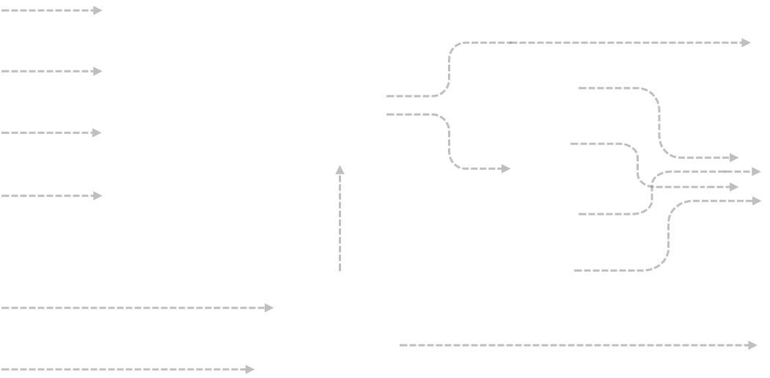
LEGACY DATA LANDSCAPE
Data Sources
BI / Analytics
ETL
OLTP databases
EDW
Datamarts
Enterprise applications
Third-party
Web apps
Other
Data Lake or Hadoop

Slide 4

MODERN DATA LANDSCAPE
Data Sources
BI / Analytics
ETL or ELT
OLTP databases
EDW
Logical Datamarts
Enterprise applications
Third-party
Web apps
Other
Data Lake

Slide 5



Cloud Providers
Modern, Cloud-Built Data Lake
Modern, Cloud-Built Data Warehouse
Data
Exchange
Pod

Slide 6
A DEEP DIVE INTO SNOWFLAKE’S ARCHITECTURE

Slide 7
A NEW ARCHITECTURE FOR DATA WAREHOUSING
Multi-cluster, shared data, in the cloud
Traditional Architectures
Snowflake
Shared-disk
Shared-nothing
Multi-cluster, shared data
Additional capacity requires forklift upgrade
Reads/Writes at the same time cripples the system
Replication requires additional hardware
Resizing cluster requires redistributing data. Shut down requires unloading
Each cluster requires its own copy of data (ex: test/dev, HA)
Vacuuming processes needed to maintain sort and distribution for performance
Centralized, scale-out storage that expands and contracts automatically
Independent compute clusters can read/write at the same time and resize instantly
Backed by eleven 9’s of durability SLA by underlying cloud providers

Slide 8
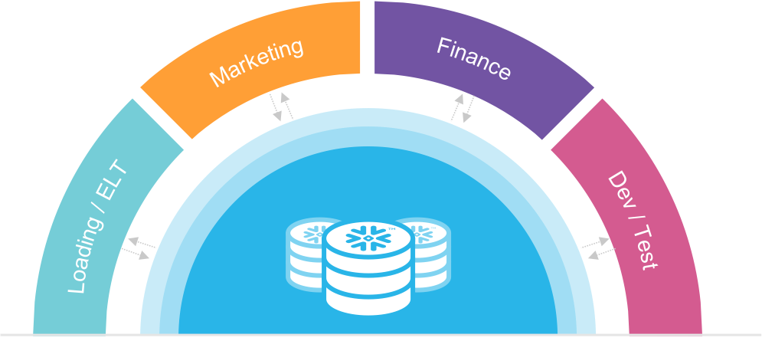
SNOWFLAKE ARCHITECTURE: STORAGE AND COMPUTE
Storage separated from compute Automatically grows without adding nodes. Never run out of space.
Resize compute instantly Scale up/down depending on the business needs right now or turn off when not in use.
Multiple clusters access data without contention ETL, reporting, data science, and applications all running at the same time without performance impact.

Slide 9
SNOWFLAKE ARCHITECTURE: GLOBAL SERVICES
Management
Optimization
Security
Availability
Transactions
Metadata
Centralized management
Separate metadata from storage and compute
Full transactional consistency across entire system (ACID)
As soon as data commits, each cluster sees the newest version

Slide 10
SEPARATE COMPUTE, SAME DATA
ETL
Elastic scaling for storage
Low-cost cloud storage, fully replicated and resilient
Elastic scaling for compute
Virtual warehouses scale up & down instantly without downtime to support workload needs
Dedicated performance SLAs
Each warehouse can access the same tables at the same time without performance penalty (including ETL)
Test/Dev/Staging/QA
Reference objects in multiple databases with one SQL statement
Elastic scaling for concurrency
Auto-scaling maintains constant query performance
Dev/QA
BI/Visualization (Auto scaling)
Data science

Slide 11
CAN YOU HANDLE THE 9AM “RUSH HOUR”?
ETL
Dev/QA
Provides consistent SLAs and performance no matter how many users/applications are accessing the system
Single virtual warehouse of multiple compute clusters
Automatically scales up and down transparently depending on changing concurrency
Clusters automatically paused and resumed to maximize concurrency while minimizing cost
BI/Visualization (Auto scaling)
Data science
BI/Visualization (Auto scaling)

Slide 12

ADAPTIVE CACHING
Metadata Metadata cached for fast access during query planning
Data Active working set transparently cached on virtual warehouse SSD
Global Services
Virtual Warehouse(s)
Query results Results sets cached for reuse without requiring compute (e.g., static dashboard queries)
Database Storage

Slide 13
RELATIONAL DATABASE EXTENDED TO SEMI-STRUCTURED DATA
Semi-structured data (JSON, Avro, XML, Parquet, ORC)
> SELECT … FROM …
Structured data (e.g., CSV, TSV, …)
Storage optimization
Transparent discovery and storage optimization of repeated elements
+
Query optimization
Full database optimization for queries on semi-structured data

Slide 14
A BETTER WAY TO SHARE DATA
Data Providers
Data Consumers
No data movement Share with unlimited number of consumers
Ready to use Consumers can immediately start querying
Live access Data consumers immediately see all updates

Slide 15
TECHNICAL OVERVIEW OF PRIMARY USE CASES

Slide 16


STREAMING AND BATCH LOADING
Data Sources
Data Lake
Web Servers
Source Raw Data
Transformation
BI Tools
S3
Snowpipe REST API
COPY
Cloud Storage
Azure Blob
Snowflake Database
GCS
Transformation
Apps
PUT + COPY
On Premises
Augmented Data

Slide 17
DATA LOADING IN SNOWFLAKE
Structured data (CSV, TSV, …)
Metadata created
Statistics for databases, tables, columns, & files calculated & stored in cloud services layer
Infrastructure manager
Optimizer
Metadata manager
Security
Semi-structured data (JSON, Avro, XML, Parquet..)
Database data stored
Actual data in Snowflake databases & tables
Stored in Snowflake-managed cloud storage
Optimized, proprietary file format
Automatically compressed & encrypted

Slide 18
DATA STORAGE IN SNOWFLAKE
Cloud services
Metadata
Information about data stored in Snowflake
Stored & managed in cloud services layer
Stored in proprietary, fast-access, fault-tolerant, scalable datastore
Infrastructure manager
Optimizer
Metadata manager
Security
Virtual warehouses
Database storage
Database data
Actual data in Snowflake databases & tables
Stored in Snowflake-managed cloud storage
Optimized, proprietary file format
Automatically compressed & encrypted
A
B
C
D
E
F
G
H
A`
B`
C`
D`
I
J
K
L
M
N
O
P
E`
F`
G`
H`
Q
R
S
T
U
V
W
X

Slide 19
DATA PROCESSING
How to allow concurrent workloads to run without impacting each other?
Virtual warehouses
A warehouse is one or more MPP compute cluster
Use multiple warehouses to segregate workload
e.g., ETL warehouse versus query warehouse
Resizable on the fly
Adjust cluster size (up/down) based on data size and/or query complexity
Automatically add/remove clusters as level of concurrency varies
Able to access data in any database
Transparently caches data accessed by queries
Transaction manager synchronizes data access
Automatic suspend/resume when needed
Virtual warehouse A
Virtual warehouse B
Virtual warehouse C
Virtual warehouse D
ETL
Transformation
SQL
BI
SSD/RAM Cache
SSD/RAM Cache
SSD/RAM Cache
SSD/RAM Cache

Slide 20
QUERYING DATA
1
4
1
Query received by Snowflake
Sent via standard ODBC, JDBC, or web UI interfaces
Cloud services
2
Infrastructure manager
Optimizer
Metadata manager
Security
2
Planner and optimizer process query
Prune and filter, then use metadata to identify exact data to be processed (or retrieved from result cache)
3
Virtual warehouses
3
Virtual warehouse processing
Virtual warehouse scans only needed data from local SSD cache or Amazon S3, processes, and returns to cloud services
Database storage
4
Result set return
Final result processed, stored in cache for future use, and returned to client

Slide 21
CONTINUOUS DATA PIPELINES
Notes:
https://docs.snowflake.net/manuals/user-guide/streams.html
https://www.snowflake.com/blog/building-a-type-2-slowly-changing-dimension-in-snowflake-using-streams-and-tasks-part-1/ - SCD part one (streams)
https://community.snowflake.com/s/article/Building-a-Type-2-Slowly-Changing-Dimension-in-Snowflake-Using-Streams-and-Tasks-Part-2 - SCD part two (tasks)

Slide 22
Table streams: Change Data Capture (CDC)
Provide a set of changes made to the underlying table since last time
Covers all transactions previously not consumed
Consumed in a DML statement: designed for transforms (“T” in ELT)
Consuming advances the “offset” on commit - somewhat like a forward-only cursor
Multiple streams possible on a given table
Intended for retention period; O(hours) up to a day or whatever the retention period is
create or replace stream stage_changes on table stage;
insert into clicks (...) select ... from stage_changes where metadata$action = 'INSERT';
Notes:
More details in docs at https://docs.snowflake.net/manuals/LIMITEDACCESS/data-load-elt.html

Slide 23
Table Stream Examples
create table t (counter int);
create stream delta on table t;
insert into t values (1);
select * from delta;
insert into t values (2);
update t set counter= 0 where counter = 1
select * from delta
counter | METADATA$ ACTION | METADATA$ ISUPDATE | METADATA$ ROW_ID
1 | INSERT | FALSE | 10da...d10
counter | METADATA$ ACTION | METADATA$ ISUPDATE | METADATA$ ROW_ID
2 | INSERT | FALSE | 9f4b...709
1 | DELETE | TRUE | 10da...d10
0 | INSERT | TRUE | 10da...d10
// Consume “delta” in DML
// So “delta” is empty
// Consume “delta” in DML
// So “delta” is again empty
Notes:
Demo notes:
“Row” column displayed in worksheet has been skipped in output due to limited space
This should be shown in a worksheet - preferably after explaining on the slide. It is a bit more complex in worksheet to understand due to the stream consumption step

Slide 24
Table Stream Examples (continued)
insert into t values (3);
insert into t values (4);
insert into t values (5);
update t set counter = 1 where counter = 4;
delete from t where counter = 5;
select * from delta;
// Stream shows delta; not txn log
counter | METADATA$ ACTION | METADATA$ ISUPDATE | METADATA$ ROW_ID
3 | INSERT | FALSE | 77f5...b6c
1 | INSERT | FALSE | 11fc...a11

Slide 25
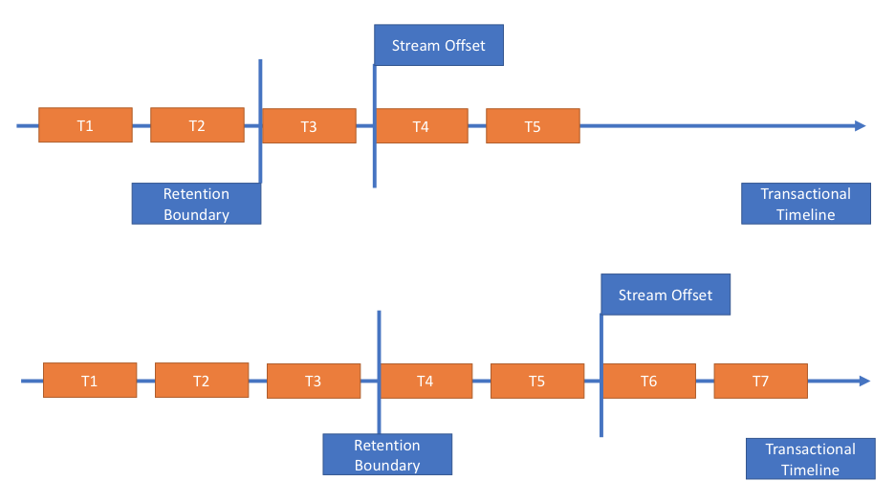
Table streams: changes since offset

Slide 26
Tasks
Executes DML statement / stored proc
Run on schedule; or
Run after predecessor task completes (pipeline scenario realized as tree of tasks)
Tasks can be used with table streams or by themselves
Table stream available for use in DML/sproc: insert, update, delete, merge
Optionally add condition on stream having data: when
Use cases include
Shred JSON/XML from staging table into multiple tables (using table streams)
Keep aggregates up-to-date and generate reports periodically
Copy data into or out of Snowflake
alter pipe … refresh to catch up on auto-ingest

Slide 27
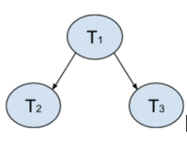
Task Examples
// Simple pipeline of three tasks
create or replace task T1
schedule = … --root of the pipeline
...
create or replace task T2
after T1 --no schedule
…
create or replace task T3
after T1 --no schedule
…
// Insert clicked ads from webserver
// log records in stage table // Run every minute create or replace task stage_to_clicks
schedule = '1 minute'
warehouse = user_task_warehouse as
insert into clicks (...) select ... from stage_changes where metadata$action = 'INSERT';
// Cron schedule instead
create or replace task some_task
schedule = 'USING CRON 0 9-17 * * SUN UTC'
…
// Run only when stream has data
create or replace conditional_task
when system$stream_has_data(stage_change) ...

Slide 28
DATA PROTECTION, SECURITY, DWaaS, AND TECH PARTNERS

Slide 29
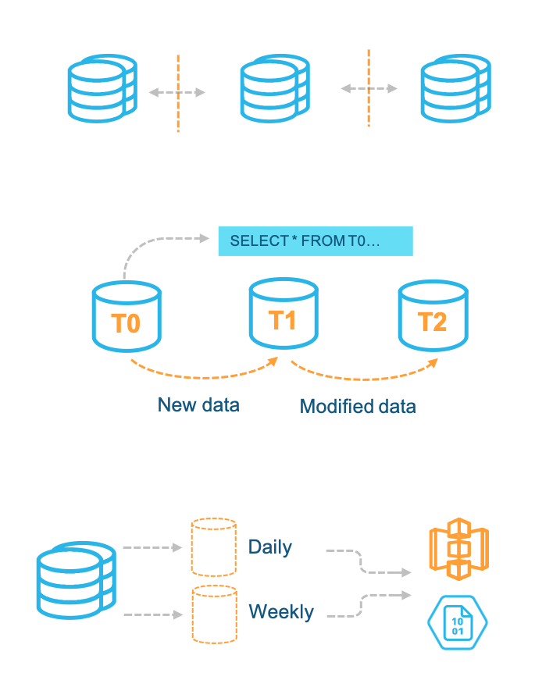
COMPREHENSIVE DATA PROTECTION
Protection against infrastructure failures
All data transparently & synchronously replicated 3+ ways across independent infrastructure
Protection against corruption & user errors
“Time travel” feature enables instant roll-back to any point in time during chosen retention window
Long-term data protection
Zero-copy clones + optional export to cloud object storage enable user-managed data copies

Slide 30
BUILT-IN AVAILABILITY
Scale-out of all tiers: metadata, compute, storage
Resiliency across redundant independent infrastructure backed by cloud provider SLAs separate power supplies built for synchronous replication
Fully online updates & patches zero downtime
Fully managed by Snowflake
Data center
Data center
Data center
Services
Cloud services
Metadata
Virtual warehouses
Database storage

Slide 31
“TIME TRAVEL” FOR DATA
> SELECT * FROM mytable AS OF T0
Previous versions of data automatically retained
Retention period selected by customer
Accessed via SQL extensions
AS OF for selection
CLONE to recreate
UNDROP recovers from accidental deletion
> SELECT * FROM mytable AS OF T1
T0
T1
T2
New data
Modified data

Slide 32
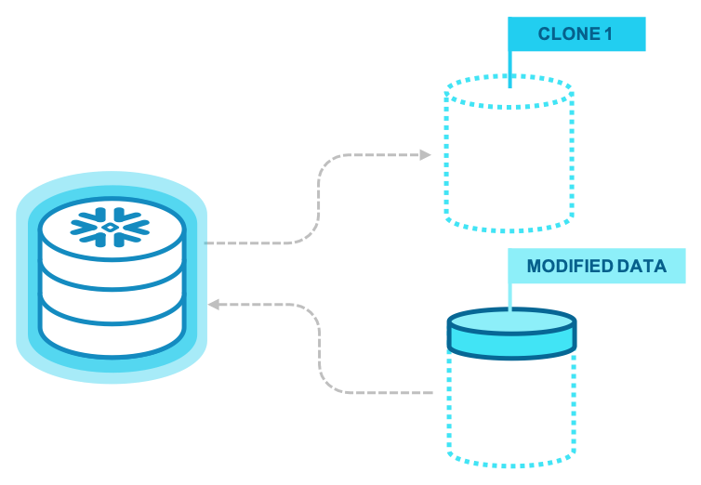
ZERO-COPY DATA CLONING
Instant data cloning operations
Databases, schema, tables, etc
Metadata-only operation
Modified data stored as new blocks
Unmodified data stored only once
No data copying required, no cost!
Instant test/dev environments
Test code on your entire production dataset
Swap tables into production when ready

Slide 33




PROTECTED BY INDUSTRIAL-STRENGTH SECURITY
Authentication
Access control
Data encryption
External validation
Embedded multi-factor authentication
Federated authentication available
Role-based access control model
Granular privileges on all objects & actions
All data encrypted, always, end-to-end
Encryption keys managed automatically
Certified against enterprise-class requirements

Slide 34






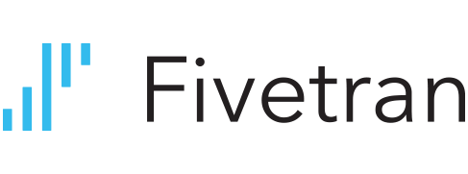











ECOSYSTEM AT-A-GLANCE
Data management and transformation
Business intelligence and analytics
Data science, apps, custom scripting
ODBC/JDBC
Scripting

Slide 35
Training Resources
Learnings
Partner Portal (webinfinity)
Partner Academy (LMS portal aka Mindtickle)
Education Services Training
Resources
Docs
Resources.snowflake.net
StackOverflow

Slide 37
CASE STUDIES

Slide 38
ENABLING KEY USE CASES
Datamart & data silo consolidation
Integrated data analytics
Exploratory & ad hoc analytics
11
10
Consolidate legacy datamarts to eliminate silos and support new projects
Directly load structured + semi-structured data into Snowflake for reporting & analytics
Direct access to data for SQL analysts to explore data, identify correlations, build & test models

Slide 39

BI AND ANALYTICS
Scenario
Pain Points
Oracle Exadata
Market research firm
Incorporate larger sets of modern data
ETL with Informatica
Need performance with scalability
Risk-averse to data loss
Profiles
Ratings
Loses
Before
User Groups
Data scientists
Marketing
Snowflake
Finance
Snowflake Value
Scalability with performance
Ability to separately scale users
Cost savings compared to legacy solution

Slide 40

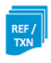
OPERATIONAL DATA LAKE
Scenario
Pain Points
Data volumes growing at 2TB per hour
Need to provide concurrency for 43,000 internal and external users
Data warehouse powers Nielsen Marketing Cloud and must be always on
Existing Netezza is not able to perform difficult queries while loading data
Cost to maintain hardware and software becoming prohibitive
Hadoop is not a real database – Need ANSI SQL
Source
ODS
Stage
Multiple Data
Marts
Source
In database
transformations
Users, tools, and Website
directly query the data
Snowflake Value
Grow storage independent of Compute (500TB to 2PB)
Separate Warehouses for workloads – zero contention
Manage data in one place without data marts

Slide 41

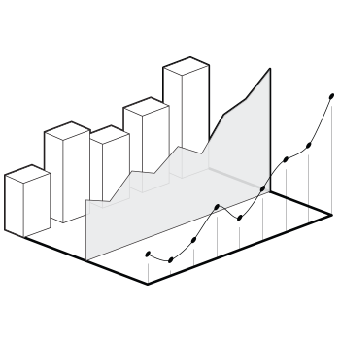
LOCALYTICS
Scenario
Pain Points
25 Trillion mobile events
Exposed to customers as an interactive data cube
Hitting limits of legacy architecture (Vertica on AWS)
Can’t support deletes or out-of-sequence updates
Snowflake Value
Only platform to handle this scale
Fraction of cost by not having to pay for the peak
Snowflake’s Zero Management service is cheaper and better

Slide 42
REAL-WORLD USE CASE
Interactive Dashboard
50% < 1s 85% < 2s 95% < 5s
Continuous Loading (4TB/day)
S3
<5min SLA
Virtual Warehouse
Auto Scale – X-Large x 5
Virtual Warehouse
Medium
Reporting (Segmented)
ETL & Maintenance
Prod DB
Virtual Warehouse
2X-Large
Virtual Warehouse
Large
4 trillion rows 3+ petabyte raw data
8x compression ratio
25M micro partitions

Slide 43

MODERNIZING DATA WAREHOUSE
Scenario
Pain Points
Entire company on GCP with business units using Snowflake
30 Node Hadoop Cluster and 46 node Vertica Cluster on premise
Extremely security focused with requirements for PCI
Using Looker and Spark
Teams wanted autonomy, but didn’t have resources to support
Vertica requires constant maintenance and suffers from outages
Performance suffers during time of intense reporting
Moving to BigQuery would create a new set of problems, Redshift had the same problems
Getting data from partners is painful and slow
REF/ TXN
Source
Hadoop
Vertica
Multiple datamarts
REF/ TXN
Source
In database
transformations
Users, tools, website
directly query data
Snowflake Value
Map their current data model easily and quickly with the same SQL
SaaS service with zero downtime
Separate Warehouses for each team – zero contention and full independence on the same data

Slide 44

DATA ANALYTICS AT EXTREME SCALE
Scenario
Pain Points
Financial institution with a huge focus on security
Overburdened staff
Business needs to run monthly reports that span 10 years of historical data
No way to analyze semi-structured data
Quoted $500,000 to replace their existing hardware appliance
20+ hours to run reports
Could not continue to scale
Users unable to query while performing ETL
Legacy DW
Microstrategy
Profiles Ratings Loses
1-2 days
1-2 mins
Snowflake Value
120x faster – from 20 hours to 45 minutes
Ad-Hoc analytics available to all users in minutes
Deployed in a week during the busiest time of year

Slide 45



CUSTOMER RESULTS
We can do 100 times more queries per day, helping us give our clients richer analysis far more rapidly.
Snowflake is faster, more flexible, and more scalable than the alternatives on the market. The fact that we don’t need to do any configuration or tuning is great because we can focus on analyzing data instead of on managing and tuning a data warehouse.
With Snowflake, I’m able to spin up as many as I want on demand and to spin them down and not pay for those things that I’m not using.
Snowflake is awesomely fast, allows us to store data at a low cost and deploy exactly the compute capacity needed, and does all of that without requiring tuning or tweaking.
— Balaji Rao VP Technology
— Kurk Spendlove Director Engineering
— Matt Solnit
CTO
— Craig Lancaster
CTO
Notes:
Accordant Media: uses Snowflake to perform customer segment analytics for their online advertising clients, replacing their previous approach using Amazon S3 & EMR.
JANA: uses Snowflake to store and analyze event & usage data from its mobile application.
Iovation: online security services provider uses Snowflake to give data scientists easy access to analyze diverse mobile and device data.
Soasta: uses Snowflake to provide continuously updated performance analytics to its customers.

Slide 46

AD-TECH ANALYTICS
Scenario
Pain Points
Solution
Analyze and monetize large data set of website traffic
Continue to add data from new sites
Large data volumes of traditional and JSON data
Separate data warehouse & Hadoop environments
Unpredictable performance on both data warehouse & Hadoop
All data in Snowflake (replaced 130-node Hadoop & DW)
Data analysts directly explore, build, test, and deploy new algorithms using Snowflake
Up-to-date dev / test environment in Snowflake
Snowflake Value
“Because of [Snowflake], business intelligence is moving from a cost center to a value center”
— Keith Lavery
Senior Director, BI Data and Analytics
Notes:
Stating the customer problems and challenges with the data of today
There are only maybe 20 people in the entire world that can build a cloud data warehouse from scratch – Benoit and Thierry are among them and they are backed by the highest caliber database development and engineering team.

